Slide 1
Car insurance customer segmentations MCCustomer segmentation exercise by charity mwanza march 8th, 2022 by charity mwanza march 8th, 2022

Slide 2
Project analysis slide 3
Problem Statement
The Problem
The Goal
The Value
All the customers in this company pay the same car insurance amount.
The help the marketing team target marketing towards certain type of customers who are more appropriate to their risk level
To segment customers according to their levels of risk ie;
High risky
Normal drivers
Least risky

Slide 3
Project analysis slide 8
Customer demographic summary
60392 claims were opened
All the customers paid the same amount of annual premiums = $716.53
All the drivers age category ranged from 1 to 6
The customers were from 6 different regions which are; A, B, C, D, E, F
Over 75% of the customers have no open claims

Slide 4
Project analysis slide 8
Customer metrics available
vehicle age
Age category
Number of claims
Cost of claims
Vehicle value
Vehicle body type
Months insured
Claim office
credit score
Gender
Policy number
Policy effect date
Drivers’ date of birth
Area
Traffic index
Annual premiums

Slide 5
Project analysis slide 2
Customer metrics used in analysis
Age category
Number of claims
Metrics
Vehicle age
Cost of claims

Slide 6
Methodology
Data Pre-Processing
Select algorithm and evaluation metric
Choose the best parameter for the algorithm
Append the final cluster assignment to the original dataset
Test different parameters of the selected algorithm and evaluation metric
Identify and interpret groupings

Slide 7
Project analysis slide 8
Segmentation according to clusters
High risky customers
Low risky drivers
4, 6, 9
2, 3, 5, 7
Low credit score
Most of the divers are young
High cost of claims
High vehicle age
High credit score
All age categories
Lower than average vehicle age
Lowest claim costs
Normal drivers
1, 8, 10, 11
All age categories
Higher than average vehicle age
Higher than average credit score
Lower than average claim costs

Slide 8
Project analysis slide 10
Recommendations
Group 1
High Risky drivers
Highest claim costs
Pay the highest premiums
Group 2
Normal drivers
Average claim costs
Average premiums
Group 3
Least risky drivers
Least claim costs
Pay low premiums

Slide 9
Thank You Questions? Charity Mwanza

Slide 10
Part 2
Detailed presentation

Slide 11
Methodology
Data Pre-Processing
Remove unwanted data
This includes columns and rows with null values
Fit data using MinMaxscaler
This reduces the all the data in the columns to have values that range between 0 and 1
Scale updated data frame to be clustered
Select algorithm and evaluation metric
Algorithm
Kmeans
Hierarchical method)
Evaluation metric
silhouette score
Inertia

Slide 12
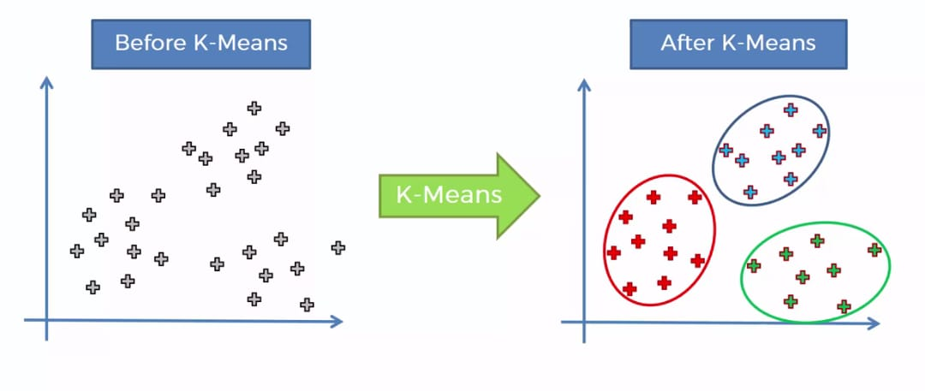
KMeans
KMeans is widely used and known for data clustering.
The following are the major advantages of Kmeans;
Its simple to implement
Easily adapts to new examples
Generalizes to clusters of different shapes
Disadvantages of Kmeans
Requires numerical data in columns
Outliers cause problems to the dataset

Slide 13
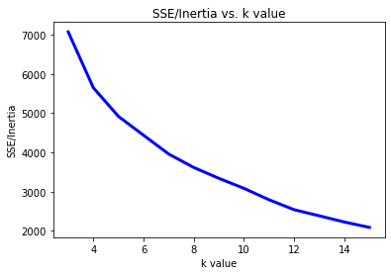
KMEANS Analysis
I tested k in range of 3 to 15 clusters
Elbow method was used to test these clusters where k was plotted against the inertia values
According to the graph below the elbow is between 8 and 12
Below is the elbow method graph

Slide 14
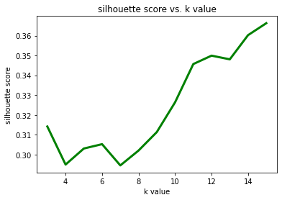
Kmeans silhouette score
This is the second evaluation method that I used for KMeans
According to the silhouette score graph below and the elbow method in the previous slide, it is reasonable to say that 11 clusters are good for this dataset.

Slide 15
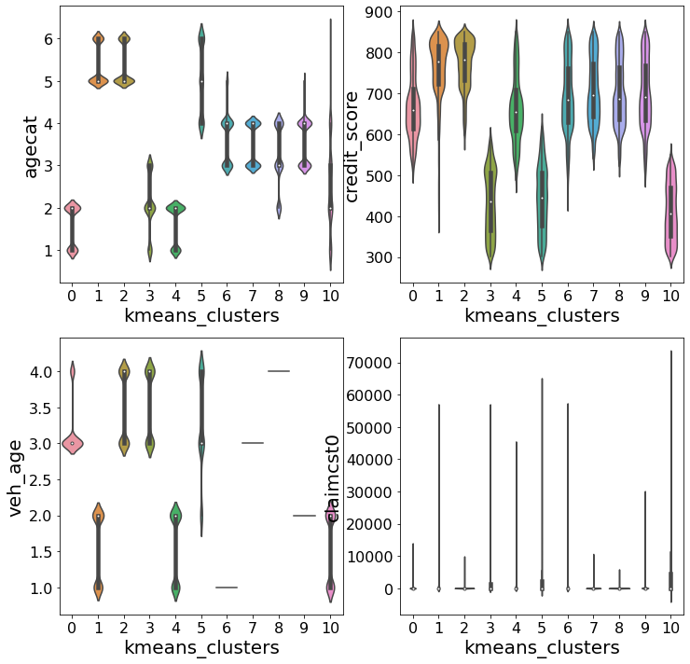
Plotting the dataset in clusters

Slide 16
Project analysis slide 8
Segmentation according to clusters
High risky customers
Low risky drivers
4, 6, 11
1, 3, 8, 9, 10
Low credit score
Most of the divers are young
High cost of claims
High vehicle age
High credit score
All age categories
Lower than average vehicle age
Lowest claim costs
Normal drivers
2, 5, 7
All age categories
Higher than average vehicle age
Higher than average credit score
Lower than average claim costs

Slide 17
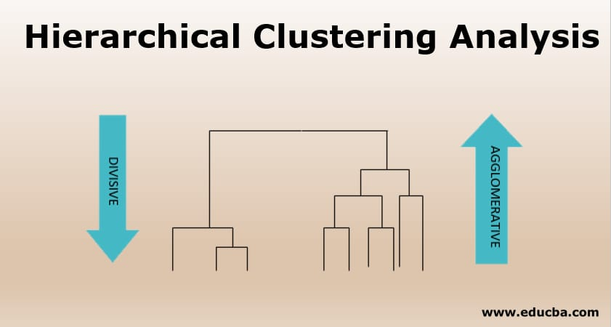
Hierarchical method
Why?
This method seeks to build hierarchies of clusters.
Dendrograms used in this method provide good data visualization tool for the clusters.
Provide hierarchical relations between clusters
Able to capture concentric clusters
It is easy to understand and build.
However;
Not easy to define levels for clusters

Slide 18
…continued
To reduce running time, the data was randomly sampled ie only 10% of the data was used in analysis
Silhouette score was used as the evaluation metric and sorted in ascending order
After sorting, it was clear that the data had the highest silhouette score of 0.338 with 2 clusters.
0 | silhouette_score
0 | 2 | 0.338776
1 | 3 | 0.290228
2 | 4 | 0.244736
6 | 8 | 0.237397
5 | 7 | 0.235624
4 | 6 | 0.234547
7 | 9 | 0.234101
17 | 19 | 0.23

Slide 19
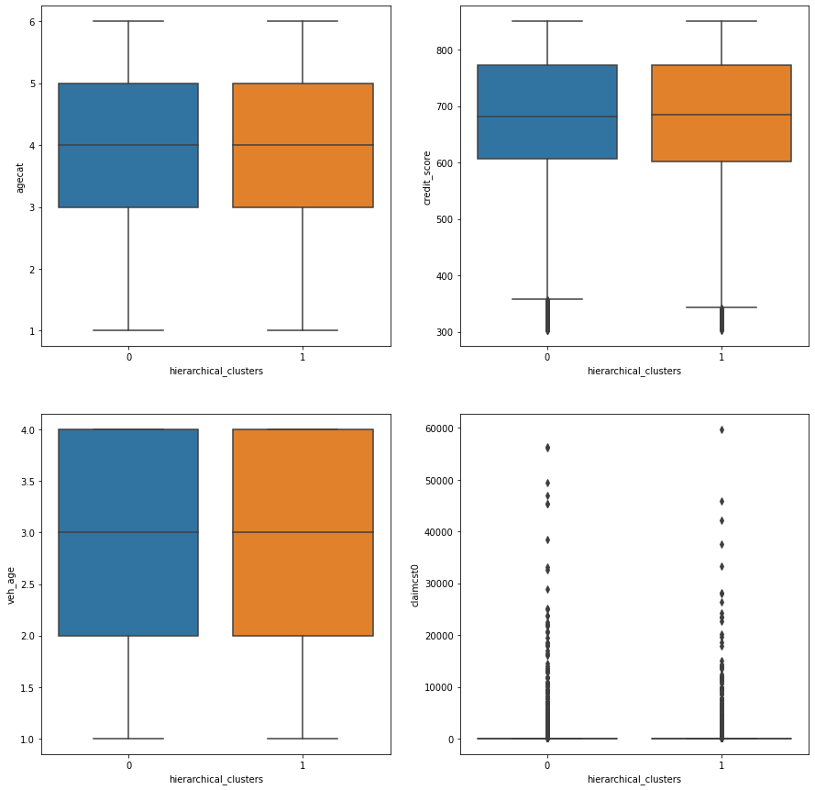
…continued
The original updated dataset was sampled and clustered into two clusters.

Slide 20
Hierarchical clustering analysis
This dataset was too large to be clustered into two clusters according to the hierarchical method.
As a result, the two clustered produced by this data had the same characteristics which made it unreasonable to rely on method of clustering for decision making.

Slide 21
conclusion
KMeans method of data clustering provided better insights of this data than the hierarchical method.
It is therefore reasonable to the information provided by the KMeans method for decision making.

Slide 22
Project analysis slide 10
Recommendations
Group 1
High Risky drivers
Highest claim costs
Pay the highest premiums
Group 2
Normal drivers
Average claim costs
Average premiums
Group 3
Least risky drivers
Least claim costs
Pay low premiums

Slide 23


